Slide 1
Lung Cancer Convolutional Neural Network
By: Paul Tuccinardi

Slide 2
Problem Statement and Hypothesis
Finding a way to better diagnose various types of lung cancers
The goal for this project is to be able to create a model that will accurately detect various forms of lung cancer. If the model has an accuracy of 70% then the model should be able to accurately predict various forms of lung cancer.
If the model trains on appropriate aspects of the images, then the model should predict which type of lung cancer the image is.
If the data has enough variations of each type of lung cancer, then the model will perform better at detecting different types of lung cancer

Slide 3
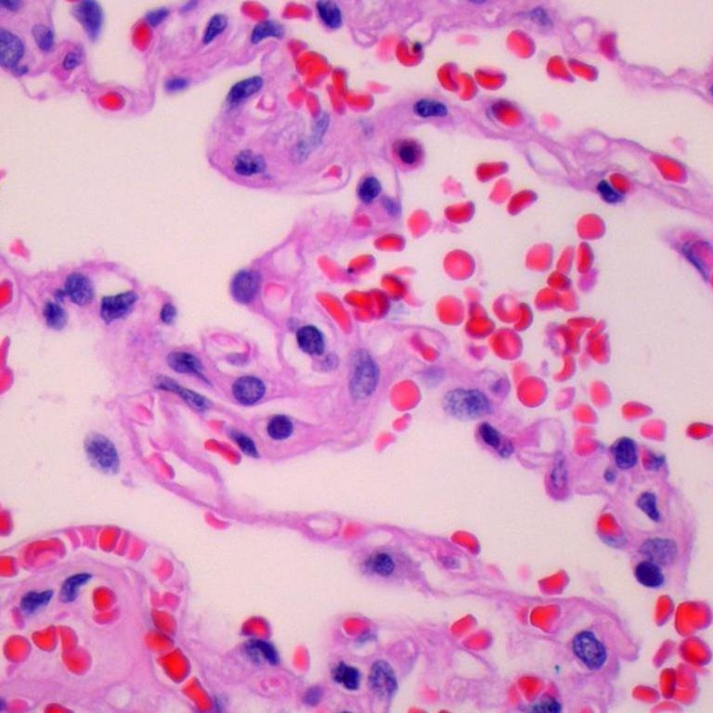
Dataset
Dataset contains images of 3 different lung cancers:
  Adenocarcinoma
  Benign
  squamous cell carcinoma
Each type of lung cancer has 5000 images
There were folders created for train, validation and test data.
80% of the data was used in the train dataset, 10% for validation and 10% for test

Slide 4

Model
The model used for this project was a Convolutional Neural Network
The model contained 9 various layers utilizing ReLU and softmax to classify the images into 1 of 3 classes
Performance was very good for both train and validation datasets
Both have accuracy 95% or greater

Slide 5
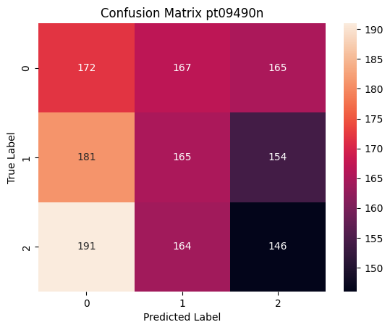
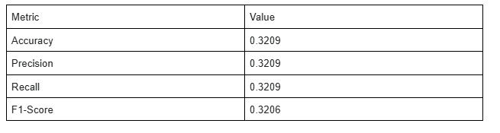
Results
Overall poor performance with test data
The model created was overfitted
Unlike with the train and validation datasets, the test dataset had an accuracy of 32%
Looking at the Confusion Matrix the data is spread out in all areas showing the poor performance the model had with the test dataset.

Slide 6
Conclusion
Even though the model had a train and validation accuracy above 90% the test data did not perform well only having performance metrics 32%
In future additions to this project:
Change parameters to find a better model
Data augmentation
Add other types of lung cancer and various stages of lung cancers
Add images of healthy lungs

Slide 7
Questions?

